Slide 1
C#

Slide 2
Objective
At the end of this module you would be able to explain the fundamentals of CSharp as a programming language

Slide 3
Topics
Visual Studio
Programming fundamentals
Object Oriented Concepts & Exception Handling
Collections & Generics
I/O
Delegates & Events
Threading
Attributes
Garbage collection and Memory Management
LINQ
TFS

Slide 4
CSharp programming
Evolution of C, C++ as programming language for DotNet
CSharp or C# and VB are programming languages of DotNet framework

Slide 5
First program using Notepad
Code file comprise of
Use Notepad to create a file and save with .cs extension
Class file with required Namespace reference
Compile code using CSharp compiler and generate executable
Run the executable

Slide 6
Visual Studio

Slide 7
Explain the need and benefits of Visual studio IDE
One Integrated environment to create
Various project types
Choose any development language to create the application
Has features to view complete solution with any number of projects
Has option of integration with Source control mechanisms for code management

Slide 8
Explain different project types that could be created thru Visual studio
Visual studio enables to create the following project types
Console application – Command prompt type of application
Windows Forms application – Applications that run on Windows Operating System
Web application – Applications that would be hosted on internet
Windows Services – Batch job type of applications
Web Services – Application logic exposed on the internet, thru web service and web method for other applications to consume

Slide 9
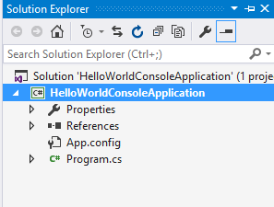
Describe Solution explorer options to view files in a project
Feature in Visual studio IDE that will show the application related files, ordered logically as per the project
An example

Slide 10
Programming Fundamentals

Slide 11
DataTypes
Predefined Types
Int
Byte
Char
Object
String
Possible to create own types
All Data and code is defined within a Type
Notes:
C# program is a collection of types
Classes, structs, enums, interfaces, delegates
C# provides a set of predefined types
E.g. int, byte, char, string, object, …
You can create your own types
All data and code is defined within a type
No global variables, no global functions

Slide 12
Variables
Variables are identifiers associated with values.
They are declared by writing the
variable's type
name
Optionally initialized in the same statement by assigning a value.

Slide 13
Variables
Declare
int iDefaultValue; // Declaring an uninitialized variable called ‘iDefaultValue', of type 'int'
Initialize
int iDefaultValue; // Declaring an uninitialized variable
iDefaultValue = 35; // Initializing the variable
Declare & Initialize
int iDefaultValue = 35; // Declaring and initializing the variable at the same time

Slide 14
Variables
Multiple variables of the same type can be declared and initialized in one statement.
int iSource, iDestination;
// Declaring multiple variables of the same type
int iSource = 2, iDestination = 3;
// Declaring and initializing multiple variables of the same type

Slide 15
C# Data Types
Built-in data types
types available with the language
Integer
Floating point values
Boolean Expressions
Text characters
Decimal values
Other types of data.
Notes:
Data types can be described as being either:
A built-in data types
types available with the language like int or char.
A user-defined custom data types
Types created by the user such as a class or interface.

Slide 16
C# Data Types
A user-defined custom data types
Types created by the user
Struct
Interface
Enum
Notes:
Data types can be described as being either:
A built-in data types
types available with the language like int or char.
A user-defined custom data types
Types created by the user such as a class or interface.

Slide 17
C# Data Types
Each type in the Common Type System is defined as either a
Value type - struct
Reference type - class
Notes:
Types that you define by using the struct keyword are value types; all the built-in numeric types are structs.
Types that you define by using the class keyword are reference types.
Reference types and value types have different compile-time rules, and different run-time behavior.

Slide 18
C# Data Types
Anonymous Types:
encapsulate a set of read-only properties into a single object
No need to define a Type
var person= new {Name=“Bob”, Age=“30”};
Notes:
Anonymous Types:
Anonymous types encapsulate a set of read-only properties into a single object without having to explicitly define a Type in first place.
The Type name is generated by the compiler and is not available at the source code level and properties type is inferred by the compiler.

Slide 19
C# Operators
Operators:
Unary
Binary
Ternary
Others

Slide 20
C# Operators
Operator Type | Operator Example | Examples
Unary (One Operator) | Increment Operator | i++; --i; i--, ++I ,!(true)
Binary (Two Operands) | Arithmetic Operator | i=i+1 , i=i/2; i=i*3 , i=5%2 , i=i<<8 , i==5 i!=10, I <10, I >10 , i<=10 , i>=10
Ternary (Three Operands) | Conditional Operator | OurScore > OpponentScore ? "We are Winners!" : “We are Losers”;
Others | Equality Operators, Assignment Operators | Is operator, as Operator, sizeOf(), typeOf(), checked(), unChecked()
Notes:
Operators that take one operand are referred to as unary operators. For example, the increment
operator (++) .
Operators that take two operands are referred to as binary operators. For example such as arithmetic operators (+,-,*,/),.
The sole ternary operator in C# is the conditional operator (?:) and takes three operands.
C# has Primary Operators, Unary Operators, Multiplicative Operators, Additive Operators, Shift Operators, Relational and Type Operators, Equality Operators, Assignment and Anonymous Operator, Logical, Conditional, and Null Operator

Slide 21
C# Program Structure
Organization
No header files
code written “in-line”
Notes:
Namespaces
Contain types and other namespaces
Type declarations
Classes, structs, interfaces, enums, and delegates
Members
Constants, fields, methods, properties, indexers, events, operators, constructors, destructors
Organization
No header files, code written “in-line”
No declaration order dependence

Slide 22
C# Program Structure
Namespaces
Type declarations
Members
Organization
Notes:
Namespaces
Contain types and other namespaces
Type declarations
Classes, structs, interfaces, enums, and delegates
Members
Constants, fields, methods, properties, indexers, events, operators, constructors, destructors
Organization
No header files, code written “in-line”
No declaration order dependence

Slide 23
C# Program Structure
Namespaces
Types
Other Namespaces
Type Declarations
Class
Structs
Interfaces
Enums
Delegates
Notes:
Namespaces
Contain types and other namespaces
Type declarations
Classes, structs, interfaces, enums, and delegates
Members
Constants, fields, methods, properties, indexers, events, operators, constructors, destructors
Organization
No header files, code written “in-line”
No declaration order dependence

Slide 24
C# Program Structure
Members
Constants
Fields
Methods
Properties
Indexers
Events
Operators
Constructors
Destructors
Notes:
Members
Constants, fields, methods, properties, indexers, events, operators, constructors, destructors
Organization
No header files, code written “in-line”
No declaration order dependence

Slide 25
C# Program Structure
Organization
No header files
code written “in-line”
Notes:
Namespaces
Contain types and other namespaces
Type declarations
Classes, structs, interfaces, enums, and delegates
Members
Constants, fields, methods, properties, indexers, events, operators, constructors, destructors
Organization
No header files, code written “in-line”
No declaration order dependence

Slide 26
C# Program Structure
// A skeleton of a C# program
using System;
namespace YourNamespace
{
class YourClass { }
interface IYourInterface { }
delegate int YourDelegate();
enum YourEnum { }
namespace YourNestedNamespace
{
struct YourStruct { }
}
class YourMainClass
{
static void Main(string[] args)
{
//Your program starts here...
}
}
}
C# is case sensitive.
All statements and expression must end with a semicolon (;).
The program execution starts at the Main method.
Unlike Java, file name could be different from the class name.
Class, Namespace, method name to follow Pascal casing
Variables, parameters naming to follow Camel casing
Notes:
Namespaces
Contain types and other namespaces
Type declarations
Classes, structs, interfaces, enums, and delegates
Members
Constants, fields, methods, properties, indexers, events, operators, constructors, destructors
Organization
No header files, code written “in-line”
No declaration order dependence

Slide 27
C# Methods
A method is a code block containing a series of statements.
Methods are declared within a class or struct
Notes:
A method is a code block containing a series of statements. In C#, every executed instruction is done so in the context of a method.
Methods are declared within a class or struct.
The structure of method is composed of 4 elements
Access level
The return value
The name of the method
Any method parameters.

Slide 28
C# Methods
Structure of Method
Access Level
Return Value
Name of the method
Any method parameter
Notes:
A method is a code block containing a series of statements. In C#, every executed instruction is done so in the context of a method.
Methods are declared within a class or struct.
The structure of method is composed of 4 elements
Access level
The return value
The name of the method
Any method parameters.

Slide 29
C# Methods
class Motorcycle
{
public void StartEngine()
{
}
public void FillGas ( int gallons)
{
}
public int Drive ( int miles, int speed)
{ return 0;
}
}
Access level
Return Value
Method Name
Parameters
Method Structures are also called as Method Signature or Method Contract
Notes:
A method is a code block containing a series of statements. In C#, every executed instruction is done so in the context of a method.
Methods are declared within a class or struct.
The structure of method is composed of 4 elements
Access level
The return value
The name of the method
Any method parameters.

Slide 30
C# Methods
Invoking the Method in a Class
Method/ Property defined in the class can be invoked through instances only.
Instances are created using the “new” operator
Notes:
A method or a Property defined in the class can be invoked through instances only.
Instances are created using the “new” operator
Use the (.) dot operator on the instance to invoke the method or property.
Only Public/protected methods/Properties can be invoked like this.
Private Method/Properties cannot be invoked using the above technique.

Slide 31
C# Conditional statements
If-Else Statement
// if-else statement
If (condition)
{
Then-statement;
}
else
{
Else-statement;
}
Else if
{
Else-if-statement
}
//Next statement in the program
// if statement without an else
If (condition)
{
Then-statement;
}
//Next statement in the program

Slide 32
C# Conditional statements
If-Else Statement – Example:
using System;
public class IfTest
{
public static void Main()
{
Console.Write("Enter a character: ");
char c = (char) Console.Read();
if (Char.IsLetter(c))
if (Char.IsLower(c))
Console.WriteLine("The character is lowercase.");
else
Console.WriteLine("The character is uppercase.");
else
Console.WriteLine("The character is not an alphabetic character.");
}
}

Slide 33
Need and Benefits of Arrays
A datatype to store more than one element of same datatype
Supports index based operations for search, update etc

Slide 34
C# Arrays
Arrays:
Data structure that contains variables of the same type
Declared with a type
Array Types:
Single Dimensional
Multi/ Two Dimensional
Jagged Array
Notes:
An Array is a data structure that contains several variables of the same type. Arrays are declared with a type.
There are three types of array. They are,
Single Dimensional
int[] array1 = new int[5];
int[] array2 = new int[] { 1, 3, 5, 7, 9 };
int[] array3 = { 1, 2, 3, 4, 5, 6 };
Two / Multi Dimensional
int[,] multiDimensionalArray1 = new int[2, 3];
int[,] multiDimensionalArray2 = { { 1, 2, 3 }, { 4, 5, 6 } };
Jagged Array
int[][] jaggedArray = new int[6][];
jaggedArray[0] = new int[4] { 1, 2, 3, 4 };

Slide 35
C# Conditional statements
Iteration statements repeatedly execute an embedded statement
while
do
for
foreach
Notes:
Iteration statements are used to repeatedly execute an embedded statement. The statements in this group are the while, do, for, and foreach statements.
Jump statements are used to transfer control. The statements in this group are the break, continue, goto, throw, return, and yield statements.
The try...catch statement is used to catch exceptions that occur during execution of a block, and the try...finally statement is used to specify finalization code that is always executed, whether an exception occurred or not.
The checked and unchecked statements are used to control the overflow checking context for integral-type arithmetic operations and conversions.

Slide 36
Debugging
Visual studio enables debugging feature thru Breakpoints
Breakpoints can be set at any line of code. While debugging the code, the control will stop and wait for user’s command to proceed
Following commands are used in breakpoints
F9 - To set breakpoint
F10 – To Step Over to the next line of statement
F11 – To Step Into those lines of code, say inner method
F5 – To proceed with the execution

Slide 37
Type Conversion
Type Conversion
Automatic type conversions
from smaller to larger types
cast or an explicit conversion
typecast syntax is type name inside parentheses
conversion based on System. Convert class
int iSource = 5;
double dResult = 3.2;
string sData = "496";
dResult = iSource;
iSource = (int) dResult;
iSource = System.Convert.ToInt32(sData);
implicit conversion
typecast required
conversion required

Slide 38
Type Conversion
Boxing and Unboxing
Auto-convert value <==> object
value ==> object is called "boxing"
object ==> value is called "unboxing"
int iSource,iPlaceholder;
object objBoxedValue;
string s;
iSource = 32;
objBoxedValue = iSource; // boxed copy!
iSource = 19;
iPlaceholder = (int) objBoxedValue;// unboxed!
s = iPlaceholder.ToString(); // boxed!
s = 99.ToString(); // boxed!
Notes:
Comments can be added in code thru // for single line comment
Multiline comment can be created by /* [Content] */

Slide 39
C# Boxing
Boxing:
Converting value types to reference types.
Int32 intVariable = 10;
object objBoxed = intVariable; // Implicit boxing
Console.WriteLine("The Object o = {0}",objBoxed); // prints out 10
Notes:
It is not necessary to tell the compiler an Int32 is boxed to an object, because it takes care of this itself.

Slide 40
C# Unboxing
Unboxing:
Converting value types to reference types
Example: how to unbox a reference type back to a value type.
Int32 intVariable = 5;
object objBoxed = intVariable; // Implicit Boxing
intVariable = (int)objBoxed; // Explicit Unboxing
Notes:
First an Int32 is boxed to an object, and then it is unboxed again.

Slide 41
DateTime class and its features
DateTime datatype is for all operations pertaining to date and time
Properties:
Day
Month
Year
Hour
Minute
Second
Millisecond
Timespan
Functions:
Add
Subtract
Reference link: https://www.c-sharpcorner.com/article/datetime-in-c-sharp/

Slide 42
C# Data Types
Value Types:
Derives from System.ValueType
Contain values (memory is allocated in the Stack registers)
No separate heap allocation or garbage collection
Notes:
Types that you define by using the struct keyword are value types; all the built-in numeric types are structs.
Value Types:
Value types derive from System.ValueType, which derives from System.Object.
Value types directly contain their values, which means that the memory is allocated in the Stack registers.
There is no separate heap allocation or garbage collection overhead for value-type variables.

Slide 43
C# Data Types
Reference Types:
the actual type will be created in the heap memory
address of the memory is stored in the stack.
Class
Delegate
Array
interface
Notes:
Types that you define by using the class keyword are reference types.
Reference types and value types have different compile-time rules, and different run-time behavior.
Reference Types:
A type that is defined as a class, delegate, array, or interface is a reference type.
When you declare a variable of a reference type, the actual type will be created in the heap memory and the address of the memory is stored in the stack.

Slide 44
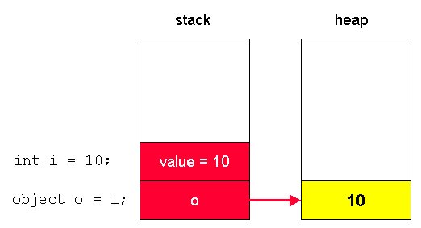
C# Data Types
Value types directly holds the value assigned.
Object types are created in Heap memory.
4884
4884
The Stack reference of the object type contains the address of heap memory.
The value type is here “Boxed” into heap memory
44

Slide 45
C# Data Types
A user-defined custom data types
Types created by the user
Struct
Enum – Used for meaningful enumeration set
Notes:
Data types can be described as being either:
A built-in data types
types available with the language like int or char.
A user-defined custom data types
Types created by the user such as a class or interface.

Slide 46
Object Oriented Programming

Slide 47
Object Oriented Programming
OOP
software development paradigm
split a program in building blocks called objects
Notes:
Object Oriented Programming (OOP) is a software development paradigm that suggests developers to split a program in building blocks known as objects.
Everything in OOP is grouped as "objects“.
OOP is implemented by sending messages to object.
It allows to define the objects data, functions, and its relationship with other objects.

Slide 48
C# Classes
A class is an object factory
Once a class is defined, any number of objects can be created which belong to that class.
A Class is a construct
enables you to create your own custom types
groups together variables of other types, methods and events.
Notes:
A Class is a construct that enables you to create your own custom types by grouping together variables of other types, methods and events.
It is a blueprint of an object.
It defines the data and behavior of a type
A class is an object factory. Once a class is defined, any number of objects can be created which belong to that class.

Slide 49
C# Classes
Class syntax:
[attributes] [modifiers] class identifier [:base-list]
{
class-body
}
Notes:
Attributes (optional)
Attributes hold additional declarative information.
Modifiers (optional)
The allowed modifiers are new, static, virtual, abstract, override, and a valid combination of the four access modifiers
Identifier
The name of the Class
Base-list (Optional)
A list contains the base class and any implemented interfaces, separated by commas
Class-body
Declarations of the class members – Properties and Methods

Slide 50
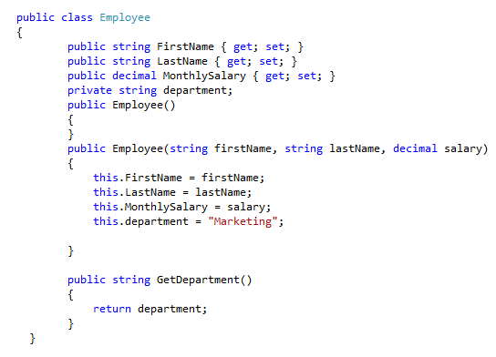
C# Classes
Class Name
Properties
Constructors
Methods
Notes:
The purpose of an abstract class is to provide a common definition of a base class that multiple derived classes can share.

Slide 51
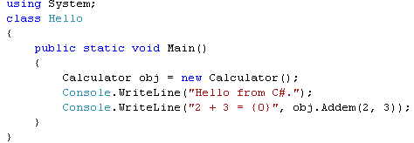
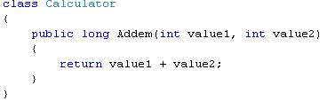
C# Objects
Run-time instance of a class.
Contains both data and procedures.
Integration of state variables and behaviors result in an object.
Creating a new instance of Calculator class with new operator
obj is the variable that holds the newly created instance of Calculator
51
Notes:
An object is a run-time instance of a class.
It contains both data and procedures.
Integration of state variables and behaviors result in an object.
An object asks another object to perform an action by sending it a message.

Slide 52
C# Static Methods & Variables
Static classes
used to create data and functions
can be accessed without creating an instance of the class
Used a separate data and independent of any object identity
Data and functions do not change regardless of what happens to the object
Class declared as static contains only static members
Not possible to create instance of a static class using new keyword
Features of a static class:
Contain only static members.
Cannot be instantiated.
Sealed.
Cannot contain Instance constructors

Slide 53
C# Static Members
Declared using the static keyword before the member declaration
Normal class can have static members
A static method, field, property, or event is callable on a class though no instance of the class is created.
Notes:
A normal class can have static Members
A static method, field, property, or event is callable on a class though no instance of the class is created.
Only one copy of the static members exists irrespective of the number of instances created for the class
Static methods and properties can only access static fields and static events.
Static class members are declared using the static keyword before the member declaration

Slide 54
C# Access Modifiers
All types and type members have an accessibility level
Controls whether they can be used from other code in your assembly or other assemblies
Declared Accessibility | Meaning
Public | Access is not restricted
Protected | Access is limited to the containing class or types derived from the containing class
Internal | Access is limited to the current assembly
Protected internal | Access is limited to the current assembly or types derived from the containing class
private | Access is limited to the containing type

Slide 55
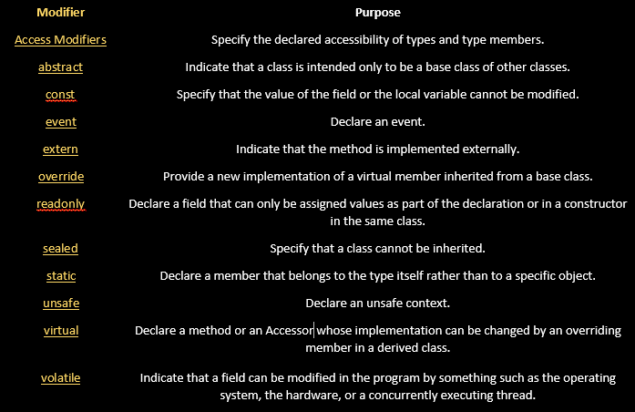
C# Access Modifiers

Slide 56
Object Oriented Programming
Encapsulation
Storing data and functions in a single unit (class)
encapsulate the unnecessary things to outside the world
Objects cannot “see” each other
Notes:
Storing data and functions in a single unit (class) is known as encapsulation.
Encapsulation promotes “information hiding”.
Objects cannot “see” each other.
Data cannot be accessible to the outside world.

Slide 57
Object Oriented Programming
Inheritance
- Can inherit the features of another class
- One class is the parent class of another
Notes:
A class can inherit the features of the another class and add its own modifications.
“Inheritance aids in the reuse of code”.
A subclass inherits all the attributes and behaviors of the superclass and may have additional attributes and behaviors.

Slide 58
Object Oriented Programming
Inheritance
Original or Parent Class
Superclass
Child or Derived Class
Subclass
Subclass
Subclass

Slide 59
C# Properties & Indexers
Properties
Mechanism to read, write, or compute values of private fields
Can be used as public data member but are special members called Accessor
Provides safety and flexibility of methods

Slide 60
Explain what is Composition of Class
Logical relationship between classes is Composition of Class
Example: A class on player skill could be instantiated in Player detail class
Reference link: https://social.msdn.microsoft.com/Forums/en-US/0b6677dc-3eb6-4eae-9c8f-c042ccbfefb3/what-is-composition-in-c-?forum=csharplanguage

Slide 61
Object Oriented Programming
Abstraction
used to display only necessary and essential features of an object
Classes use the concept of abstraction and are defined as a list of abstract attributes
Notes:
Abstraction refers to the act of representing essential features without including background details.
Classes use the concept of abstraction and are defined as a list of abstract attributes.
Abstraction is used to manage complexity.

Slide 62
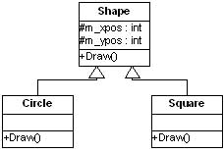
Object Oriented Programming
Polymorphism
Exhibit different behaviors in different instances
Polymorphism is extensively used in inheritance.
Notes:
Polymorphism is the ability to take on multiple forms.
The operation may exhibit different behaviors in different instances.
The behavior depends on the data types used in the operation.
Polymorphism is extensively used in inheritance.

Slide 63
C# Method Overloading
Method overloading
more than one method
has the same name
each method have a different signature
Different signatures
Different parameters order or
Different parameters data types or
Different number of parameters for each method or
Combination of all above.

Slide 64
C# Method Overriding
Feature in Polymorphism where child class provides a different implementation for the method defined in the parent class
Parent class has to define a method to be overridable using the keyword ‘override’ for it to be overriden

Slide 65
Interfaces
An interface in C# is a pure abstract class
Interfaces looks like a class, but has no implementation.
It contain only definition of events, indexers, methods and/or properties.
Interfaces inherited by classes and structs, which must provide an implementation for each interface member defined.
All interfaces should be declared with the keyword interface.
It is possible to implement any number of interfaces in a single derived class, but you should provide signatures to all methods.
C# does not support multiple inheritance, but using interfaces it can do that.
In interface all the methods are abstract.

Slide 66

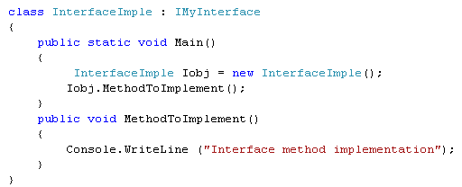
Interfaces (Contd.)
Defining an Interface:
Using an Interface:

Slide 67
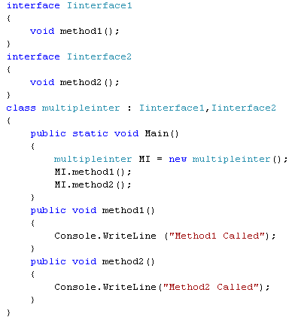
Interfaces (Contd.)
Multiple inheritance using interfaces:
Output:
Method1 Called
Method2 Called

Slide 68
Exception Handling

Slide 69
Exceptions – Overview
An exception
Is a problem that arises during the execution of a program
provides a way to transfer control from one part of a program to another.
Can be generated by
common language runtime (CLR),
.NET Framework or any third-party libraries
application code.
Notes:
A C# exception is a response to an exceptional circumstance that arises while a program is running, such as an attempt to divide by zero.

Slide 70
Exceptions – Overview
C# exception handling is built upon four keywords:
try,
catch,
finally, and
throw.
Notes:
A C# exception is a response to an exceptional circumstance that arises while a program is running, such as an attempt to divide by zero.

Slide 71
Exceptions – Overview
try:
A Identifies a block of code for which particular exceptions is activated
catch:
A program catches an exception with an exception handler at the place in a program where you want to handle the problem
finally
The finally block is used to execute a given set of statements, whether an exception is thrown or not thrown.
throw
Throws the exception to the calling method
Notes:
A Try block is followed by one or more catch blocks.
The finally block is used to execute a given set of statements, whether an exception is thrown or not thrown.

Slide 72
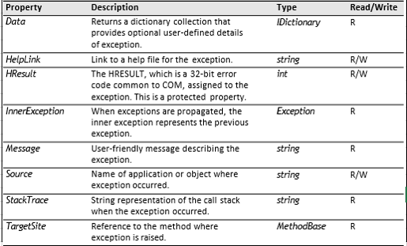
Properties of an Exception Class
Exception Class has the following properties:

Slide 73
Exception Class
The Base Class Library provides two types that inherit directly from Exception:
Application.Exception
System.Exception
ApplicationException
Is the base class for all exceptions defined by applications
The System.Exception class
Is the base class for all exceptions defined by system

Slide 74
Exceptions Handling – System Exception
System.Exception class:
Exceptions class are derived from System.Exception class.
Identifies the type of exception
contains properties that have details about the exception.
Notes:
This is the content slide. Enter the content for the topic in this slide. Ensure that comprehensive speaker notes are available for each slide.

Slide 75
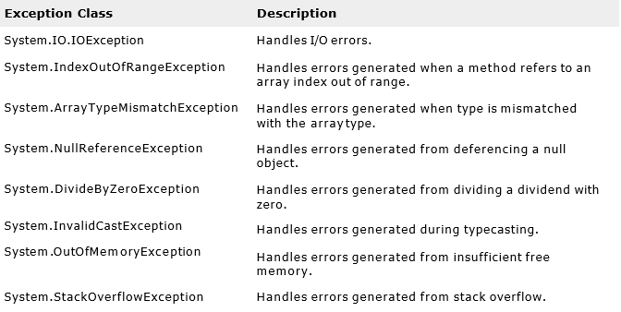
Exceptions Handling – Inbuilt exceptions
Some of the predefined exception classes are:
Notes:
This is the content slide. Enter the content for the topic in this slide. Ensure that comprehensive speaker notes are available for each slide.

Slide 76
String Class

Slide 77
String class
Special datatype for textual operations
Sequential collection of character objects
Immutable
Frequently used functions:
ToString
Split
Substring
Concatenate
ToUpper
ToLower

Slide 78
Collections & Generics

Slide 79
Collections
Collections are data structures that holds data of different types for flexible operations.
C# Collection classes are defined as part of the System.Collections
IEnumerable
ICollection
IDictionary
IList
Notes:
Most collection classes implement the same interfaces, and these interfaces may be inherited to create new collection classes that fit more specialized data storage needs.

Slide 80
Collections
ArrayList contains a simple list of values.
It is very flexible because we can add without any size information, that is it will grow dynamically and also shrink
Allows duplicate items
Example
ArrayList ItemList = new ArrayList();
ItemList.Add(“Hello");
ItemList.Add(3);
ItemList.Add(‘C’);
ItemList.Add(4.4);
ItemList.Remove(“Hello”);
ItemList.RemoveAt(2);
ItemList.Sort();

Slide 81
Collections
Hashtable represents a collection of key/value pairs which maps keys to value.
Any non-null object can be used as a key but a value can be null.
We can retrieve items from hashTable to provide the key .
Both keys and values are Objects
Cannot have duplicate keys
Example
Hashtable weeks = new Hashtable();
weeks.Add("1", "SunDay");
weeks.Add("2", "MonDay");
.
.
weeks.Add("7", "SatDay");
If (weeks.ContainsValue(“ThuDay"))
{
String fifthday=weeks["5"].ToString();
}

Slide 82
Collections
Below are the few important collection objects found in System.Collections Namespace.
ArrayList
HashTable
Dictionary
Queue
NameValueCollection
All the above collections support the basic operations like
Add
Remove
RemoveAt
Sort

Slide 83

Generics Data Type
Generic Types are Data Types which has place holders for other types to be passed on.
These place holders are referred as Generic Type Parameters
The client code that uses the generic type will provide the value for the placeholder parameter.
Now Cup is a generic type that is programmed to work with any Type T that is being supplied.
T is a placeholder- (Generic Parameter) that can
accept any type supplied
For eg, the .NET Framework type System.Collections.Generic.List<T> has one type parameter that by convention is given the name T.
Notes:
The session objectives will contain the list of learning objectives in a bulleted list
For example, the .NET Framework type System.Collections.Generic.List<T> has one type parameter that by convention is given the name T.
When an instance of the type is created the type of the objects that the list will contain is specified.

Slide 84
Collection Initializers
Initializing Collections – C#3.0 feature.
List<int> lst = new List<int>(); //eg. List Initialization lst.Add(1); lst.Add(2); lst.Add(3);
List<int> lst = new List<int>() { 1, 2, 3}; //New feature
Works for any ICollection class by calling its Add method

Slide 85
I/O

Slide 86
MemoryStream, FileReader and FileWriter
DotNet provides memory stream object to read thru and write file content
FileReader and FileWriter are components for the file manipulation operation

Slide 87
XML
XML stands for Extensible Markup Language
XML is used for describing data, holding data and transferring data between systems.
XML tags are to be defined by user.
XML is a W3C recommendation.
Advantages:
Interoperability:
Two different systems can interoperate by sending messages in the form of XML

Slide 88
Building Blocks of XML Document
The following are the elements of XML document,
Elements
Attributes
Entities

Slide 89
XML Elements
Elements are the main building blocks of an XML document
An XML document contains one or more elements.
Example: <EmployeeName></EmployeeName>
An Element can contain
Text - <EmployeeName>Raja</EmployeeName>
Another Element.
<Employee>
<EmployeeName>Raja</EmployeeName>
<Employee>
Empty - <EmployeeName></EmployeeName>

Slide 90
Delegates & Events

Slide 91
Need of Delegates
Consider a scenario where you need to make a ‘business decision’ in your program.
To make a decision you need data
To get data you need to call a method
When the method name is not known at design time
You need to pass the unknown method as a parameter
The method passing is known as a Callback function
Call back functions are pointers to methods
.NET implements function pointers using delegates
Notes:
91

Slide 92
Delegates
The most common usage of delegates is in events
Consider the implementation of a Button class by Microsoft
Button class has an event(delegate) called Click.
But OnClick it does not know what method it needs to call.
If you examine the Click event, it expects a method to be bound whose signature should match the event signature.
Event signature determines the signature of the methods to be passed/bound
Here Name of the passed/binding method is irrelevant.
Notes:
92
You define a method that contains code for performing various tasks when an event (such as a mouse click) takes place.
This method needs to be invoked by the runtime when the event occurs. Hence this method, that you defined, is passed as a parameter to a delegate.

Slide 93

Delegates: Simplified
An objectified Function:
Inherits from System.Delegate
Sealed implicitly
Looks much like C or C++ style function pointer
Example:
Declared like a function with an extra keyword delegate
Stores a list of methods to call

Slide 94
Delegates
A delegate is a type
that defines a method signature to be passed/bind to it
hence you have create an instance to work with it
so it can be passed as arguments to other methods.
To an instance of a delegate, you can associate any method with a compatible signature.
You can invoke (or call) the method through the delegate instance.
Notes:
Event handlers are nothing more than methods that are invoked through delegates. You create a custom method, and a class such as a windows control can call your method when a certain event occurs.

Slide 95
Events
Events enable a class or object to notify other classes or objects when something of interest occurs.
The class that sends (or raises) the event is called the publisher and the classes that receive (or handle) the event are called subscribers.
In a typical C# Windows Forms or Web application, you subscribe to events raised by controls such as buttons and list boxes.
Notes:
This is the content slide. Enter the content for the topic in this slide. Ensure that comprehensive speaker notes are available for each slide.

Slide 96
Events
To declare an event member, we put the event keyword in front of a delegate member. For example:
public class MyClass {
public delegate int SimpleEventHandlerDelegate(object obj1, object obj2) public event SimpleEventHandlerDelegate SimpleEvent;
}
Here, event is the Keyword, SimpleEventHandlerDelegate is the Delegate Type, and the SimpleEvent is the Name of Event

Slide 97
Threading

Slide 98
Threading: Overview
A thread
Is an independent execution path, which can run simultaneously with other threads.
Share data, if they have a common reference to the same object instance.
C# program starts in a single thread created automatically by the Common Language Runtime and operating system.
Notes:
98

Slide 99
Why Threads?
Threads are lightweight (context switch and synchronization).
It is well-specified and have carefully designed primitives.
It is simplest sufficient solution.

Slide 100
How Threading Works
Multithreading is managed internally by a thread scheduler.
On a single-processor computer
a thread scheduler performs time-slicing, rapidly switching execution between each of the active threads.
On a multi-processor computer
multithreading is implemented with a mixture of time-slicing and genuine.
Different threads run code simultaneously on different Central Processing Units (CPUs) which is referred as Concurrency.
DotNet provides Threadpool for better thread management

Slide 101
Thread facilities
The thread facilities are :
Thread Creation
Mutual Exclusion
Waiting for Events
Getting a thread out of an unwanted long-term wait
C# Facility:
The System.Threading namespace
C# lock statement

Slide 102
Attributes

Slide 103
Attributes
What is an Attribute?
An attribute is a declarative tag that is used to convey information to runtime about the behaviors of various elements like classes, methods, structures, enumerators, assemblies etc. in program.
A declarative tag is depicted by square ([ ]) brackets placed above the element it is used for.
List of predefined attributes
Serializable
Conditional
Reference link:
https://www.tutorialspoint.com/csharp/csharp_attributes.htm
Notes:
For Windows applications, this allows time-consuming tasks to be performed in the background while the application window and controls remain responsive.

Slide 104
Garbage collection and Memory Management

Slide 105
Common Language Runtime (CLR)
CLR works like a virtual machine in executing all languages.
All .NET languages must obey the rules and standards imposed by CLR.
Examples:
Object declaration, creation and use
Datatypes, language libraries
Error and exception handling
Interactive Development Environment (IDE)

Slide 106
Common Language Runtime(CLR)
Development
Mixed language applications
Common Language Specification (CLS)
Common Type System (CTS)
Standard class framework
Automatic memory management
Consistent error handling and safer execution
Potentially multi-platform

Slide 107
Memory Management: Overview
In an object-oriented environment,
Every type identifies some resource available
Use any of these resources requires memory
There is always a fixed size of memory available in a system.
Memory management is to free up the memory which was no longer used by system
The motivation for garbage-collected environments is to simplify memory management for a .Net developer.
107
Notes:
107

Slide 108
Memory Management
.NET framework stores items in either Stack or Heap memory as your code executes.
STACK and HEAP help you to run your code.
They reside in the operating memory.
The stack is responsible for keeping track of what is executing in your code
The heap is responsible for keeping track of your objects
108
Notes:
108

Slide 109
Memory Management: Garbage collector
CLR’s garbage collector is responsible to cleanup unused resources, that would not be required for the code

Slide 110
LINQ

Slide 111
LINQ-Getting Started
A Query is an expression that retrieves data from a data source.
LINQ simplifies the situation of learning query languages specific to the data sources, by offering a consistent model for working with data across various kinds of data sources and formats.
In a LINQ query developers are always working with collection of objects.

Slide 112
LINQ-Getting Started (Contd.)
This allows developers to use the same basic coding pattern to query and transform data in the following:
XML Documents
SQL Databases
ADO.NET Datasets
.NET Collections.
Other format for which LINQ format is available.

Slide 113
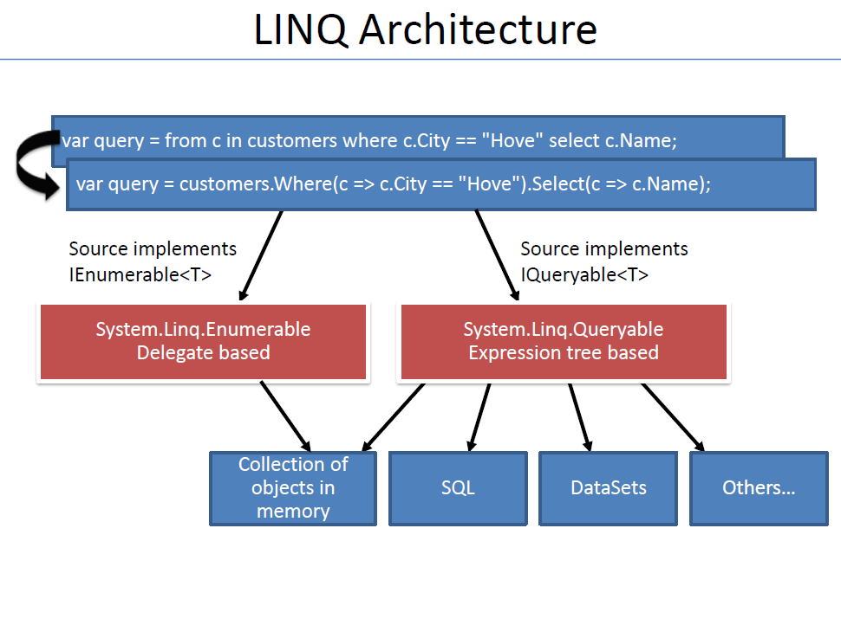
LINQ Architecture
Query execution steps:

Slide 114
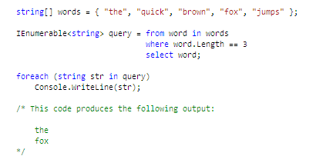
Standard Query Operators – Filtering Data
Filtering Data

Slide 115
TFS

Slide 116
What is TFS?
Microsoft Team Foundation Server for Code repository maintenance
TFS provides feature to
Create code branch to have a local code copy to work on
Check-out the existing code branch to add/modify code
Commit code thru Check-In
Merge changes done on a branch to the master branch
Reference links:
https://blogs.msdn.microsoft.com/ukvsts/2009/03/27/team-foundation-server-benefits/
https://docs.microsoft.com/en-us/azure/devops/repos/git/commits?view=azure-devops&tabs=visual-studio
https://www.youtube.com/watch?v=BwEePAcKzA4

Slide 117
Recap
In this chapter, we have learnt about:
Visual Studio
Programming fundamentals
Object Oriented Concepts & Exception Handling
Collections & Generics
I/O
Delegates & Events
Threading
Attributes
Garbage collection and Memory Management
LINQ
TFS

Slide 118
You have successfully completed –
Learning on basics of CSharp

